Slide 1
Convolutional Neural Network for Race Car Localization
Mostafa Hussein
Mohamed AbouHussein

Slide 2
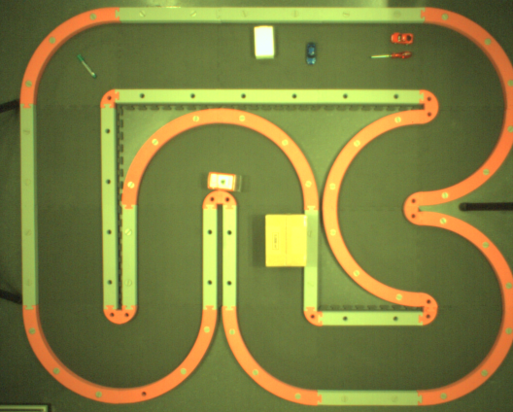
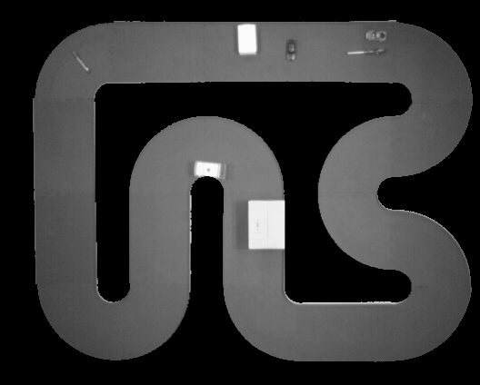

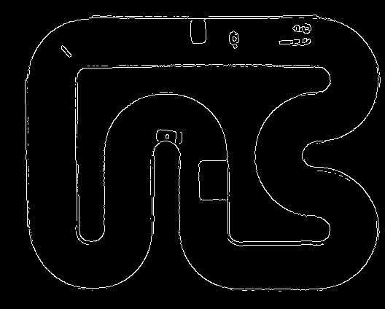
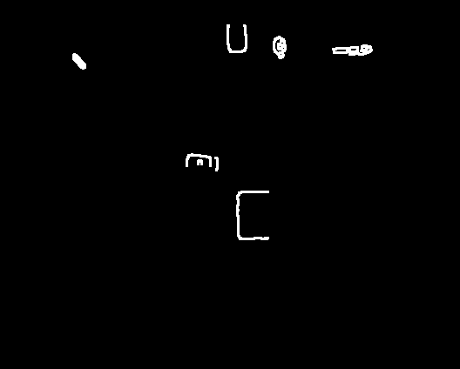
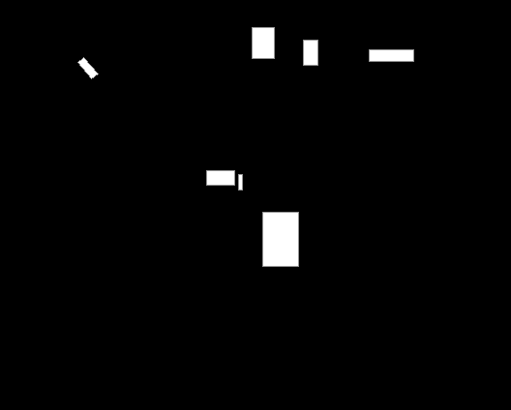
Motivation
06/02/18

Slide 3
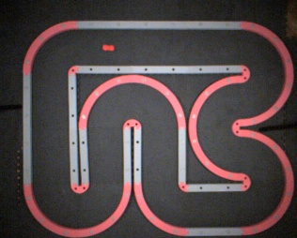
Motivation
06/02/18

Slide 4
Outline
Motivation
Introduction to Convolutional Neural Networks
Data set Preparation
Initial Model Architecture
VGG net Architecture
Optimizer
Results
Conclusion
Future Work
06/02/18

Slide 5
Introduction to Convolutional Neural Networks
Convolutional Neural Networks (ConvNets or CNNs) are a category of Neural Networks that have proven very effective in areas such as image recognition and classification
CNNs are currently the state-of-the-art solution for object detection
06/02/18

Slide 6

Introduction to Convolutional Neural Networks
Essentially, every image can be represented as a matrix of pixel values
06/02/18

Slide 7

Introduction to Convolutional Neural Networks
The primary purpose of Convolution in case of a CNN is to extract features from the input image
CNNs are trained to extract simple to complex features
06/02/18

Slide 8
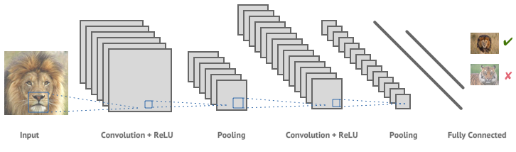
Introduction to Convolutional Neural Networks
06/02/18

Slide 9
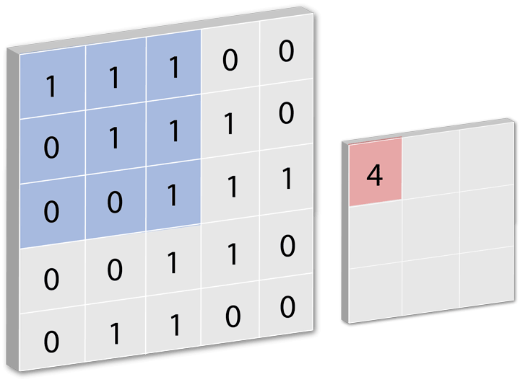
Convolution
06/02/18

Slide 10
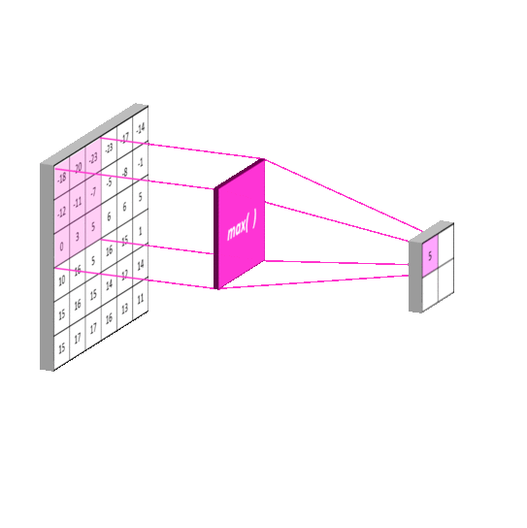
Pooling
06/02/18

Slide 11

Activations
06/02/18

Slide 12
Data set Preparation
Number of images:
Training Images: 4183
Validation Images: 465
Test Images: 60
Labels:
Format: csv
Content: Image Name, x, y, psi
06/02/18

Slide 13
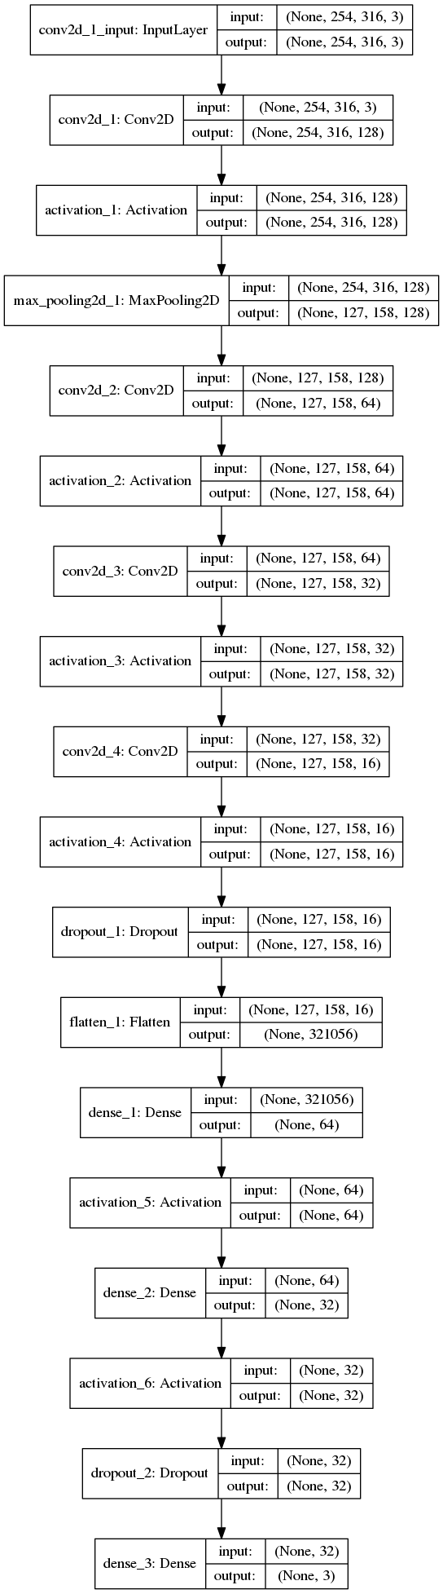
Initial Model Architecture
06/02/18

Slide 14
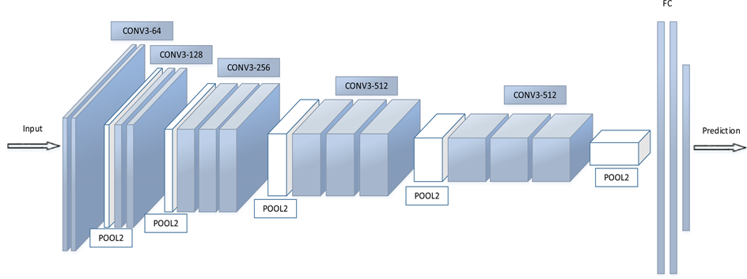
VGG Net
06/02/18

Slide 15
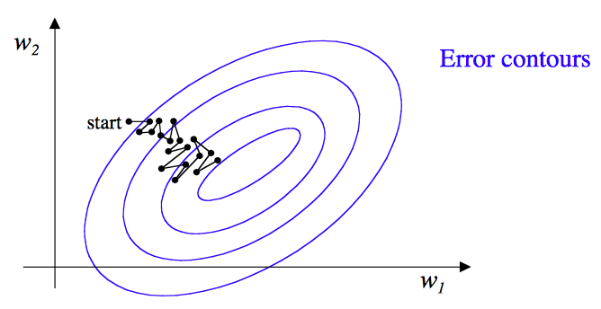
Optimizer
Stochastic Gradient Descent
06/02/18

Slide 16
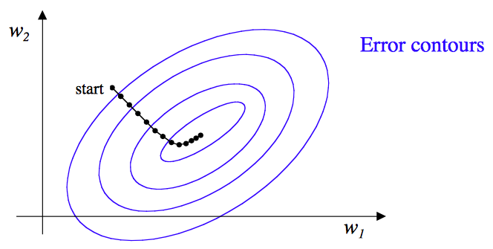
Optimizer
Adam
06/02/18

Slide 17
Results
Initial Architecture
06/02/18

Slide 18
Results
VGG Net
06/02/18

Slide 19
Results
 | Initial Architecture | VGG Net
Average x error (m) | 0.25 | 0.0152
Average y error (m) | 0.31 | 0.0153
Average psi error | 1.26 | 0.1701
06/02/18

Slide 20
Results
Demo
06/02/18

Slide 21
Conclusion
CNNs can perform well in computer vision applications
There is no need for image preprocessing (extracting features)
Two CNNs were implemented
VGG Net performance results were close to the benchmark
06/02/18

Slide 22
Future Work
Training on background noisy data can generalize the feature extraction to the race car location
The output of the network architecture can be modified to compensate for other objects localization in the image
06/02/18

Slide 23
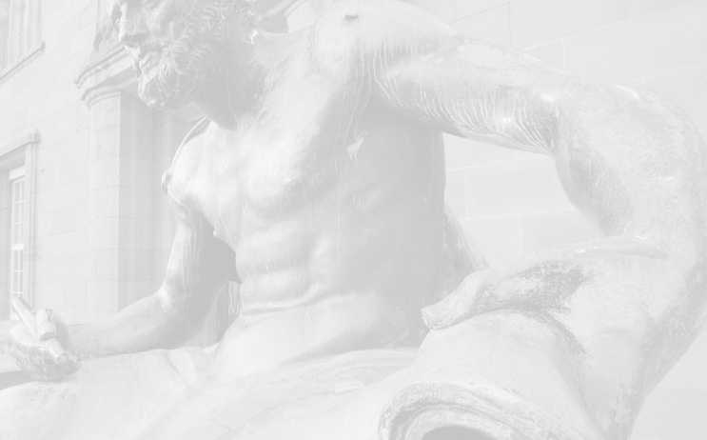
Thank you

